Slide 1




3
Power BI
Manager Guide
Prepared By :
Said Fawzy
Manager of Information Center
Tendering Department
Arab Contractors

Slide 2

Chapter 3: Modeling Data

Slide 3
01
What is a Data Model?
02
Introduction to schemas
Module Contents
Introduction to DAX
03
Creating calculated columns
04

Slide 4
05
Measures
Module Contents

Slide 5
Introduction to Data Models

Slide 6
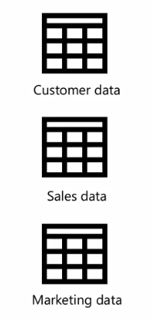
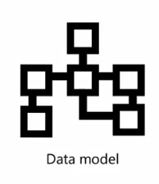

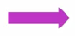
Integrating Data from Different Sources

Slide 7
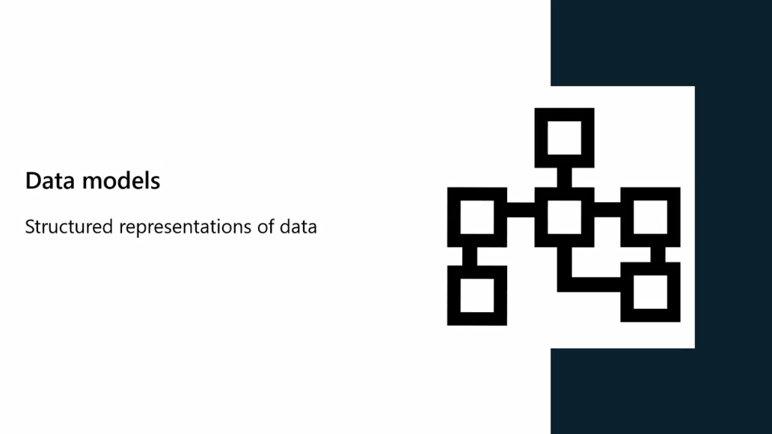

Slide 8
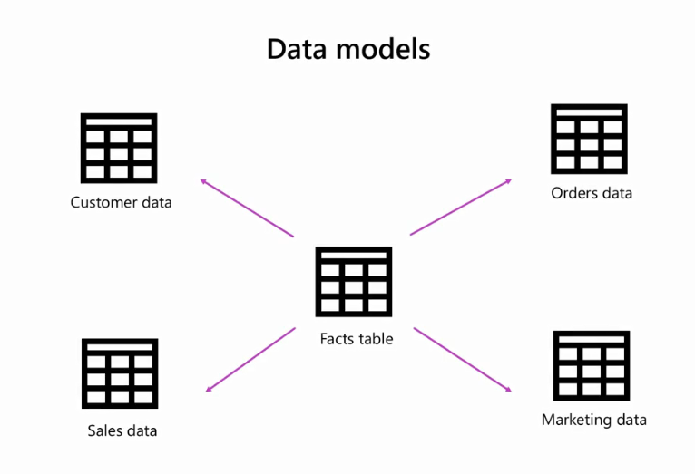

Slide 9
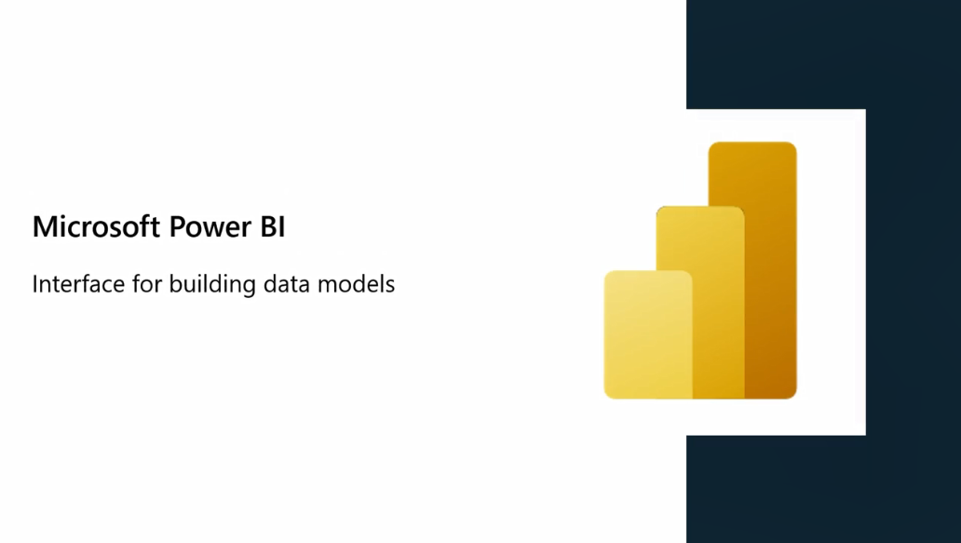

Slide 10

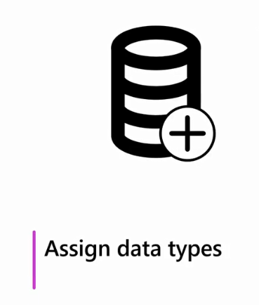
Power BI helps you to:

Slide 11
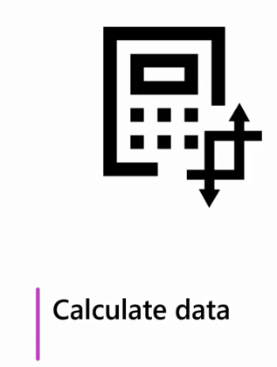
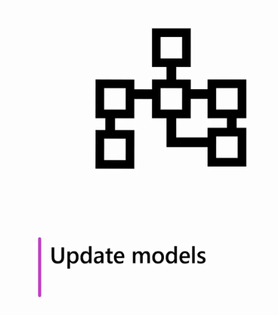
Power BI helps you to:

Slide 12
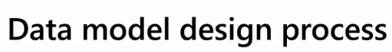
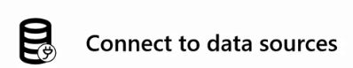
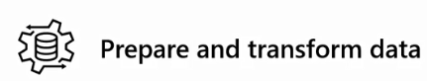
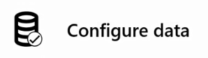

Slide 13

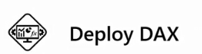

Slide 14
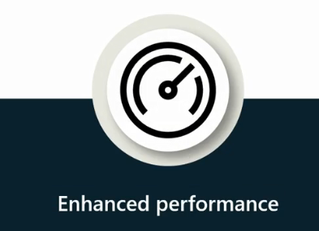
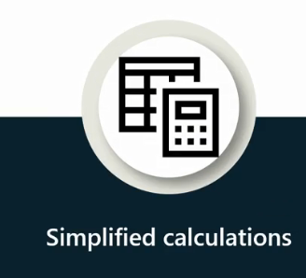
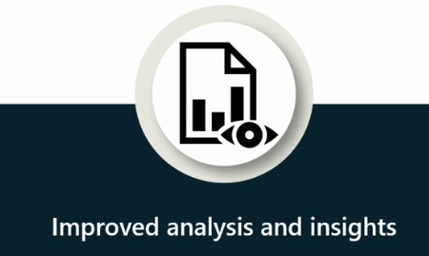
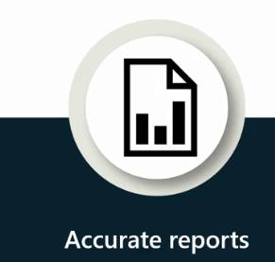
Advantages

Slide 15
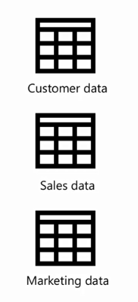
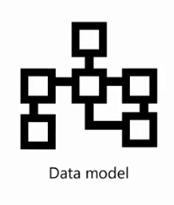
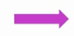
Steps to Create a Model
CTL using Power Query

Slide 16
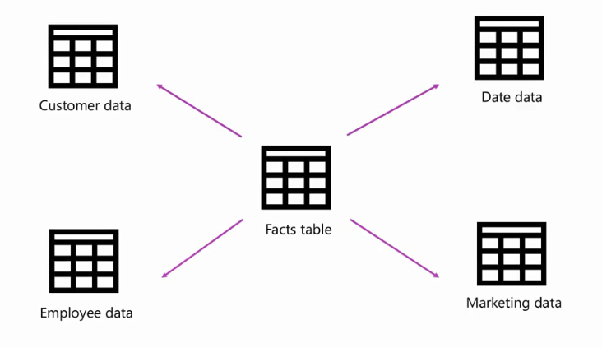
Steps to Create a Model
This Create a Data Model

Slide 17
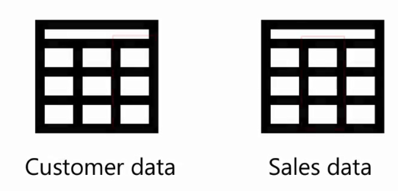
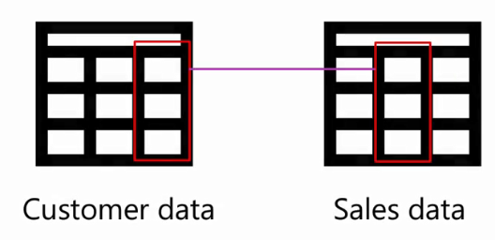
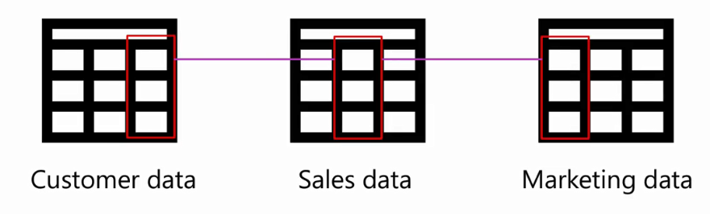
Steps to Create a Model
Define Relationship

Slide 18
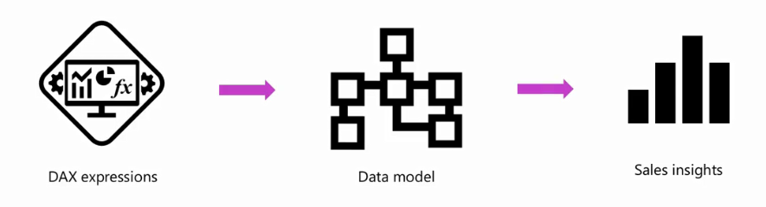
Steps to Create a Model
Create Measures using DAX

Slide 19
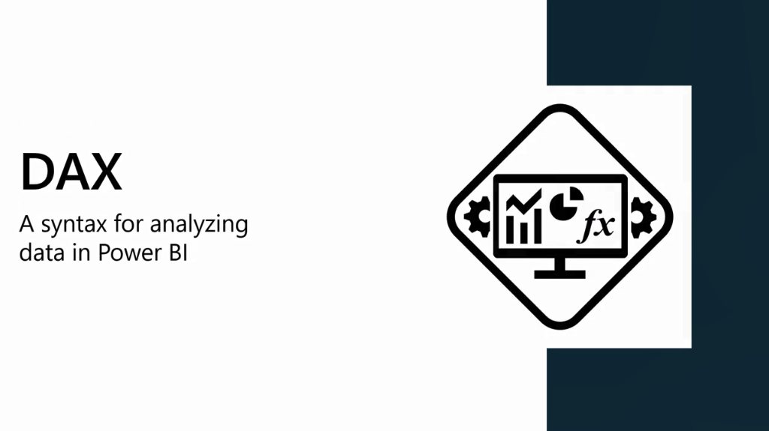

Slide 20
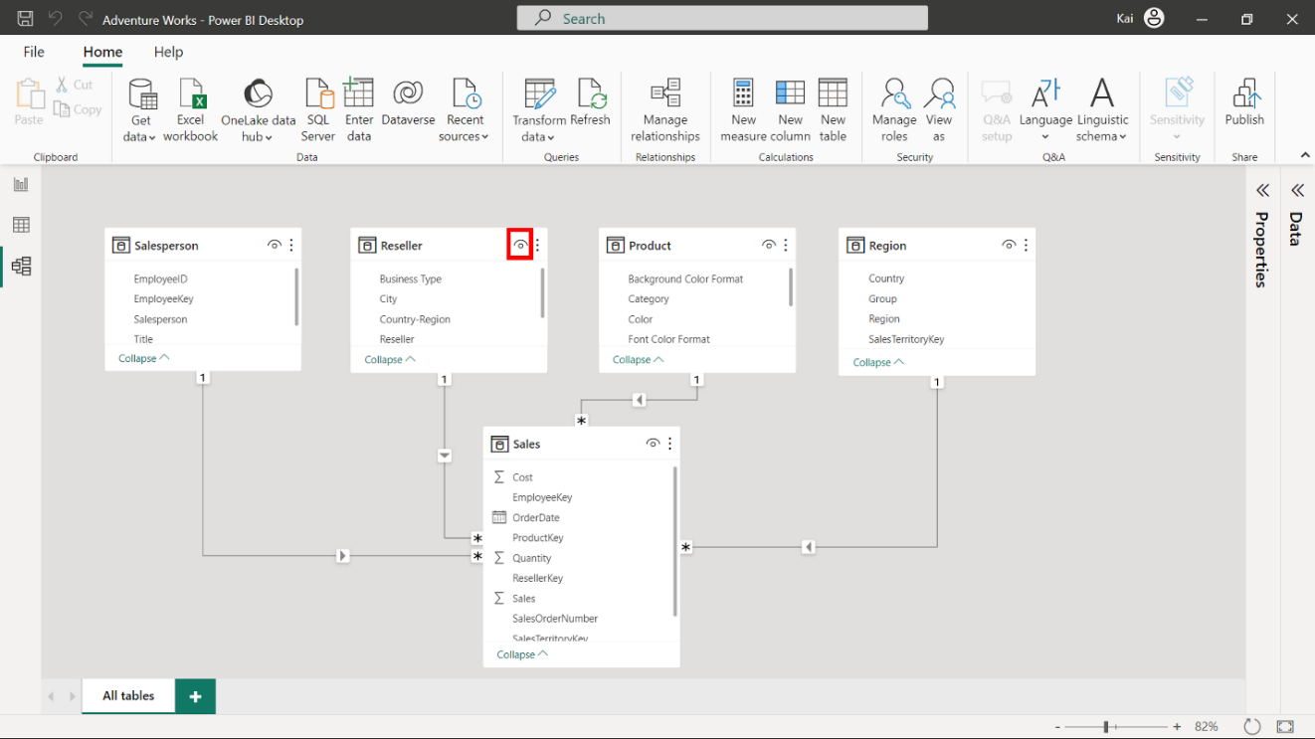
Diagram view (Canvas)
The small eye icon on the top right of the table diagram allows you to hide the table from the Power BI desktop report view

Slide 21
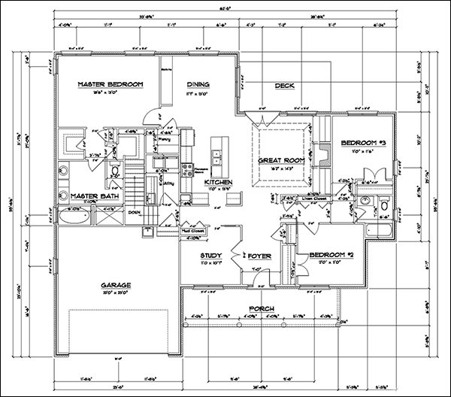
What is a Schema?
In the context of Power BI, a schema is a logical blueprint that defines the structure, organization, and relationships of tables.

Slide 22
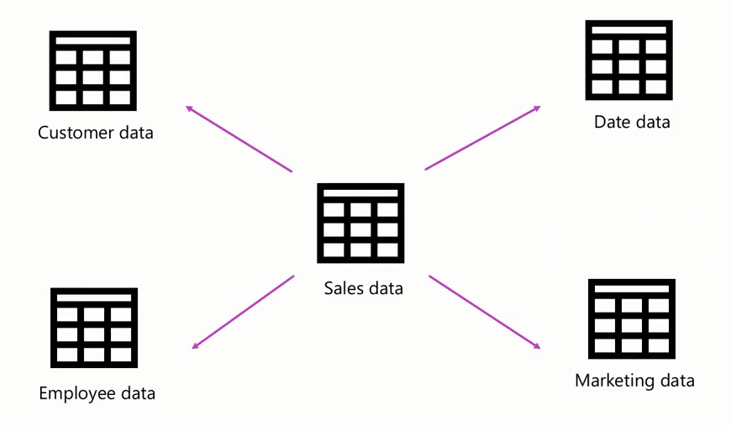
Company Schema

Slide 23
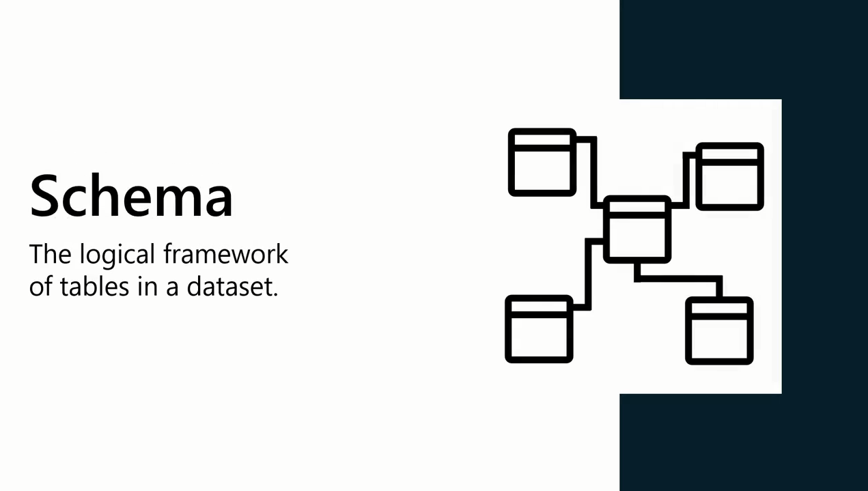

Slide 24
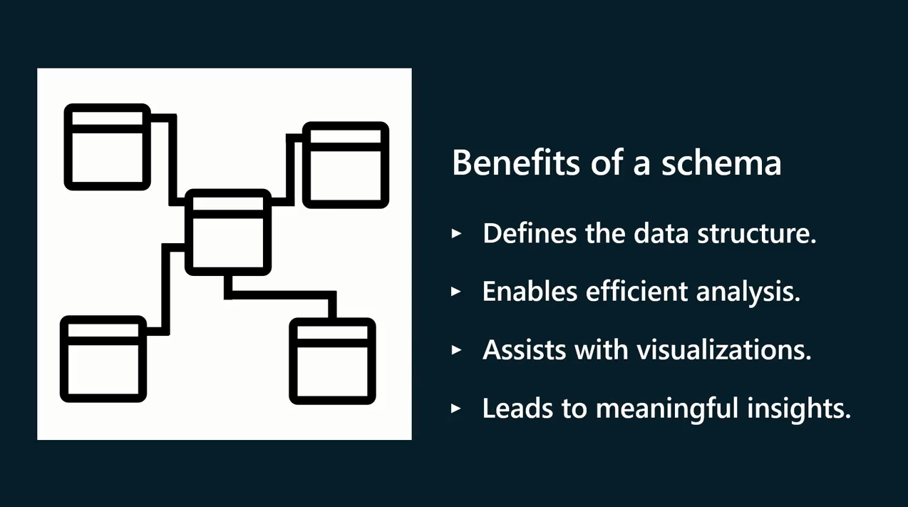

Slide 25
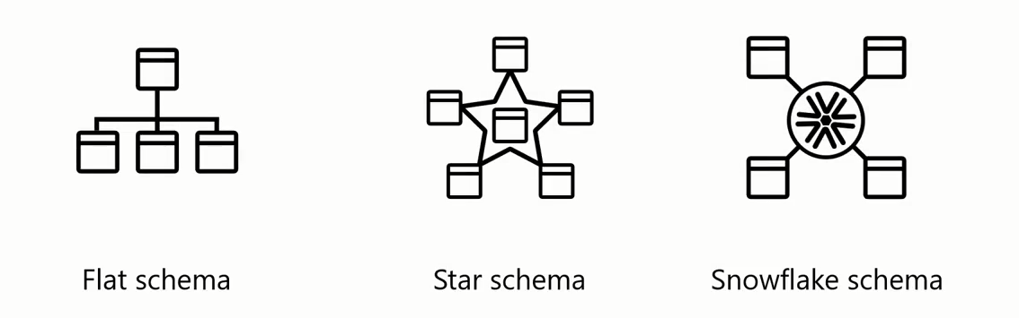
Types of Schema

Slide 26
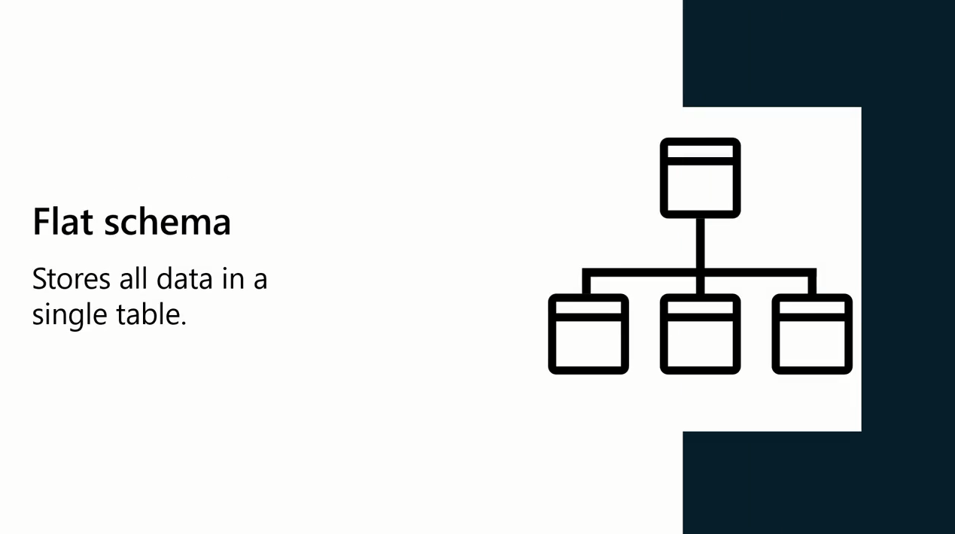

Slide 27
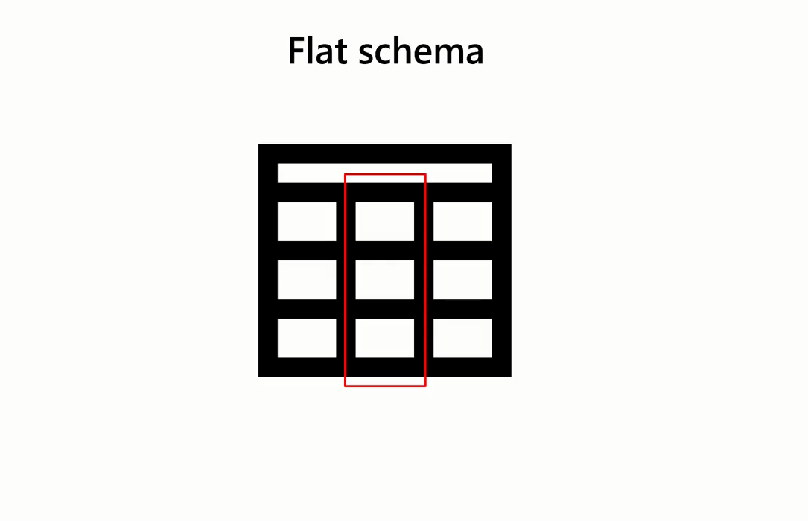

Slide 28
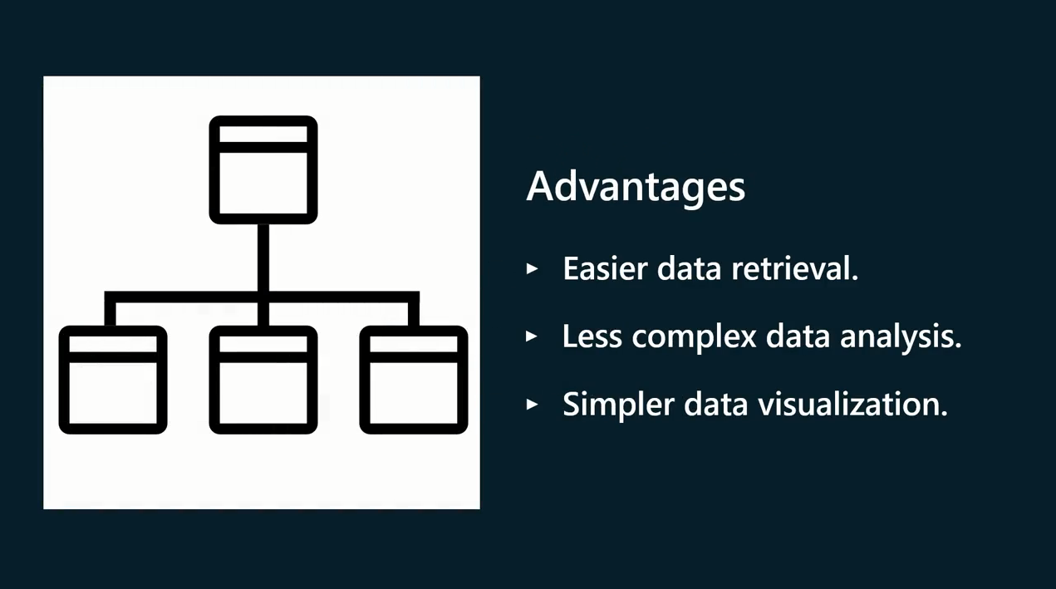

Slide 29
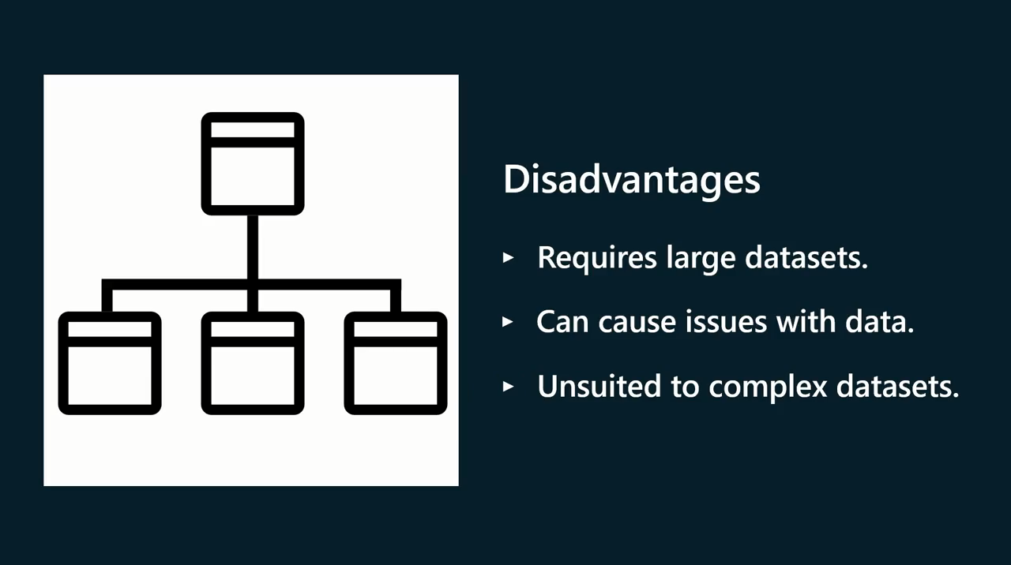

Slide 30
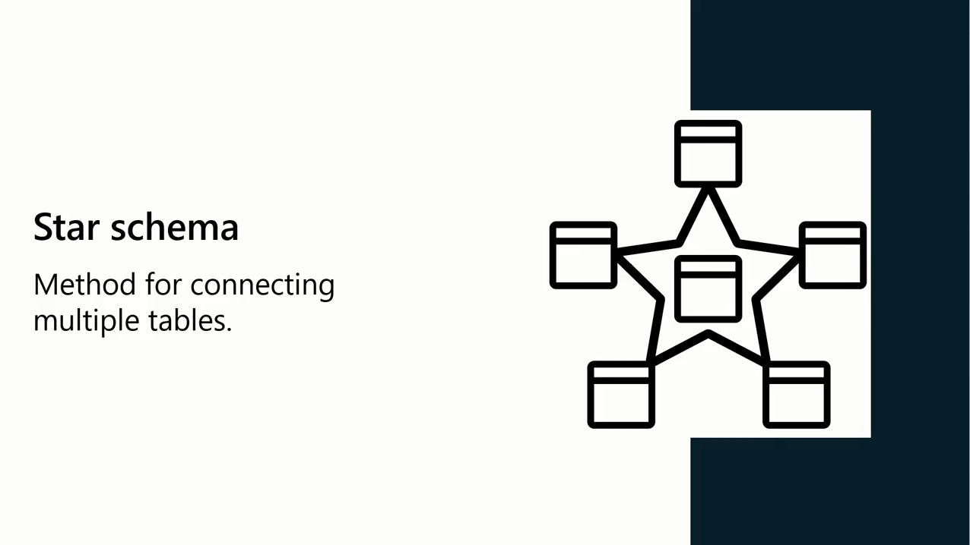

Slide 31
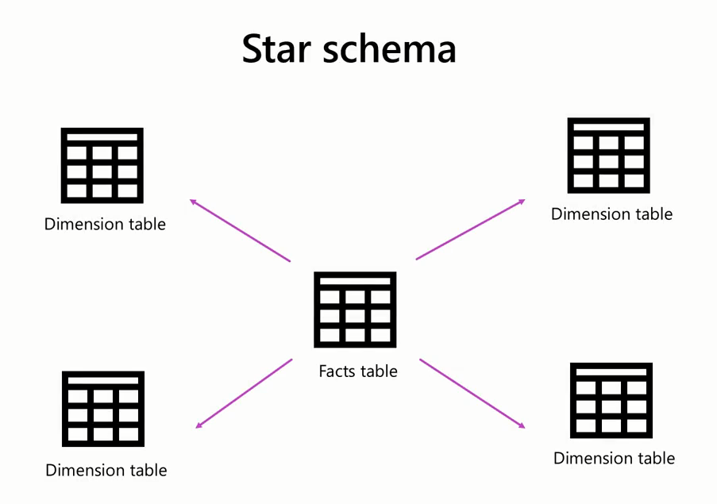

Slide 32
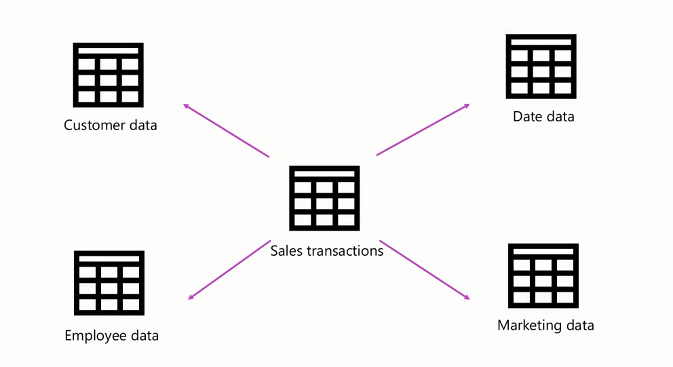

Slide 33
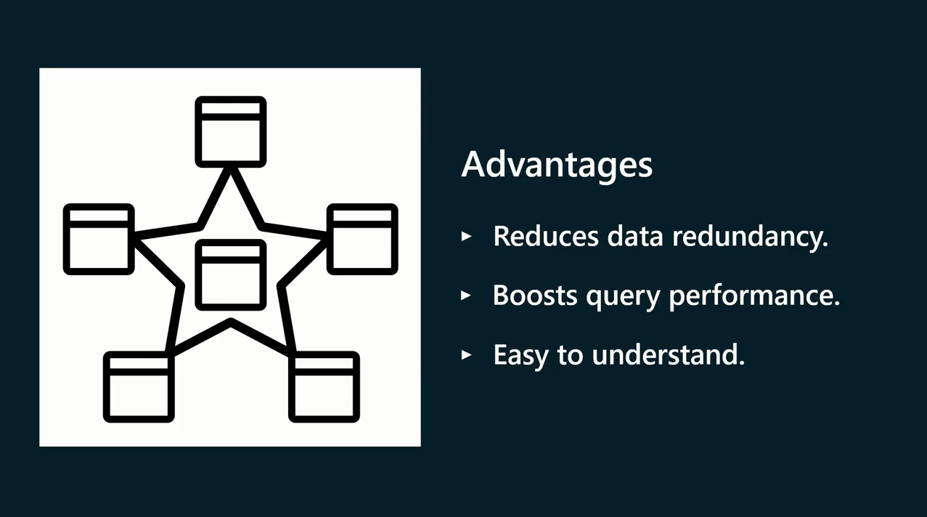

Slide 34
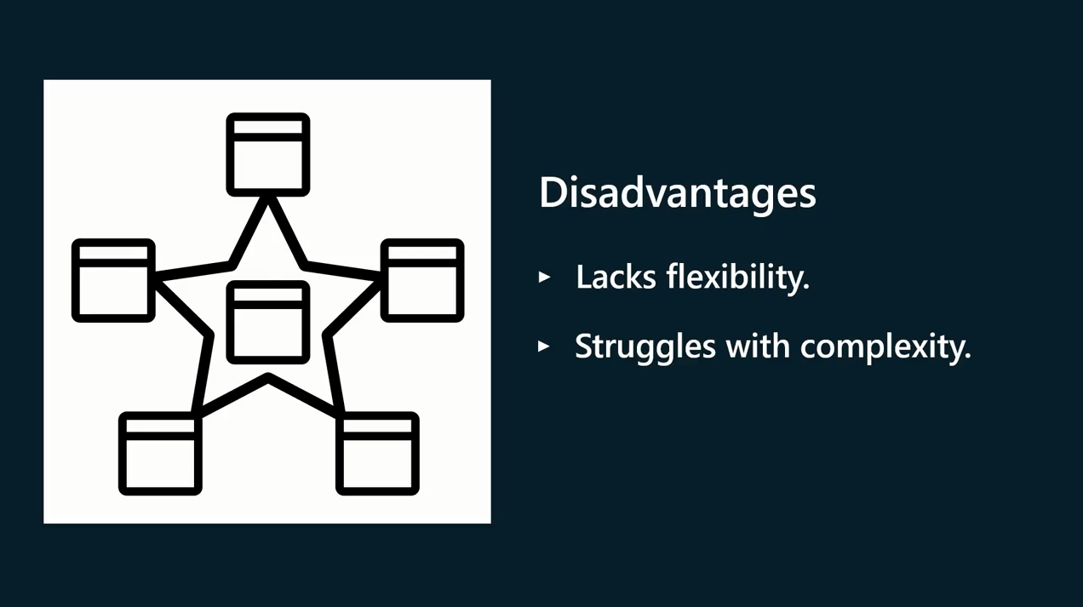

Slide 35
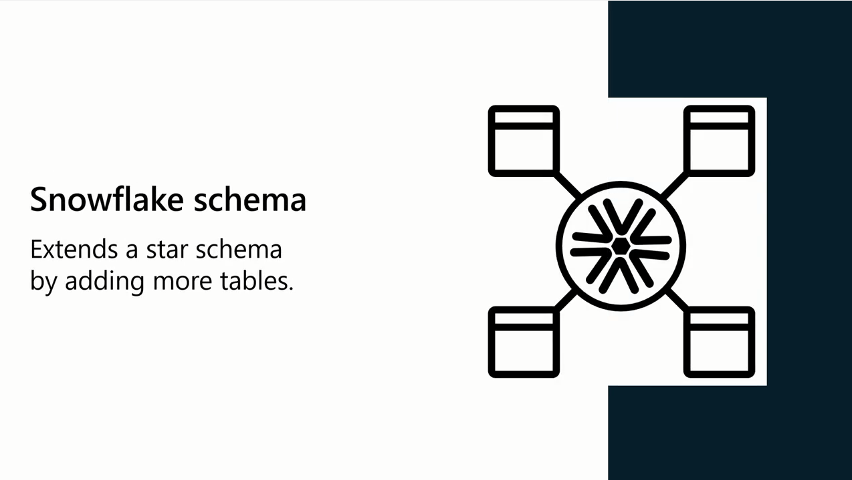

Slide 36
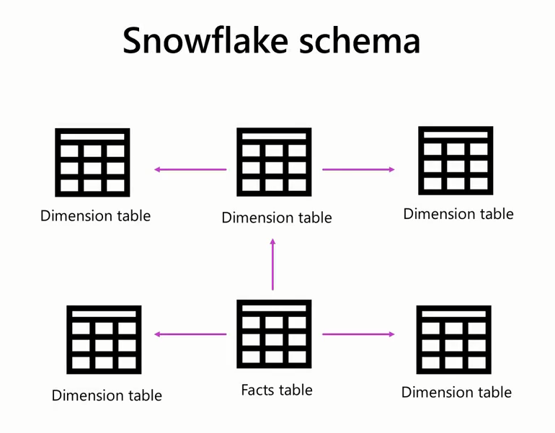

Slide 37
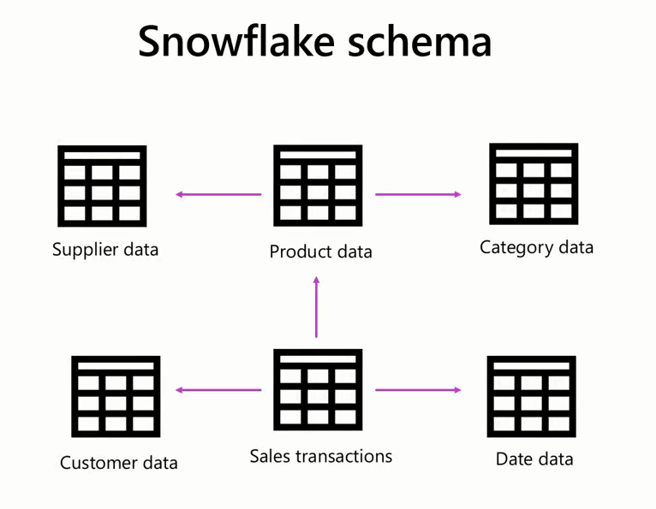

Slide 38
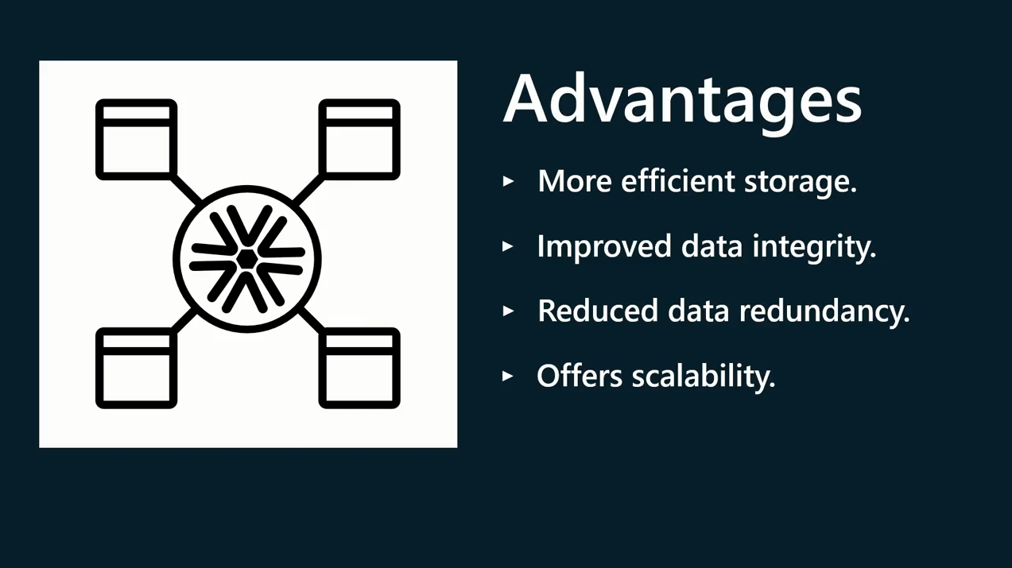

Slide 39
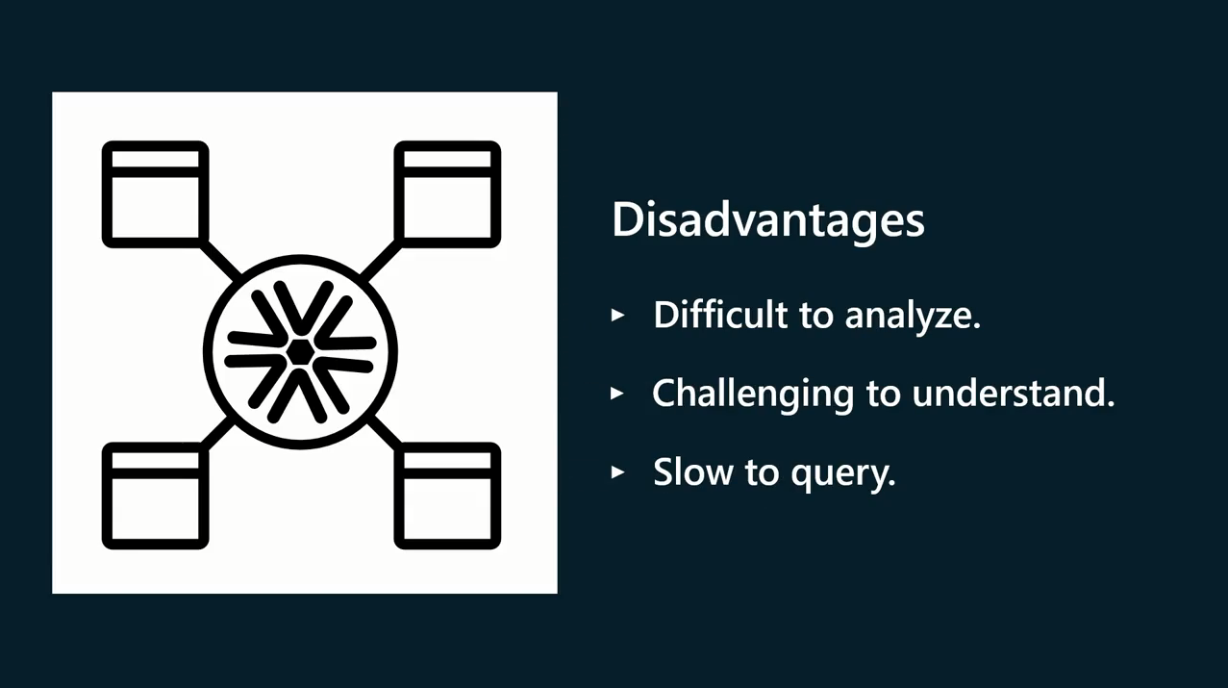

Slide 40
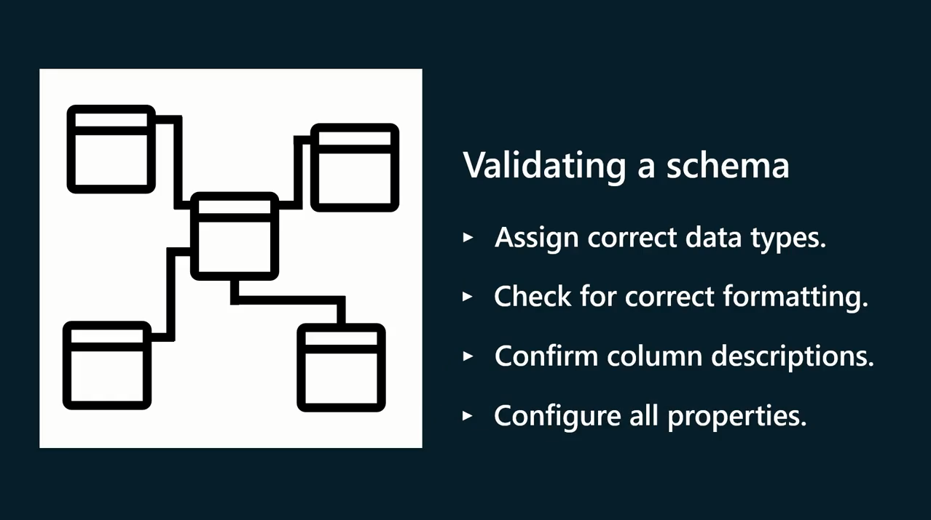

Slide 41


What is DAX ?
DAX
Power BI

Slide 42
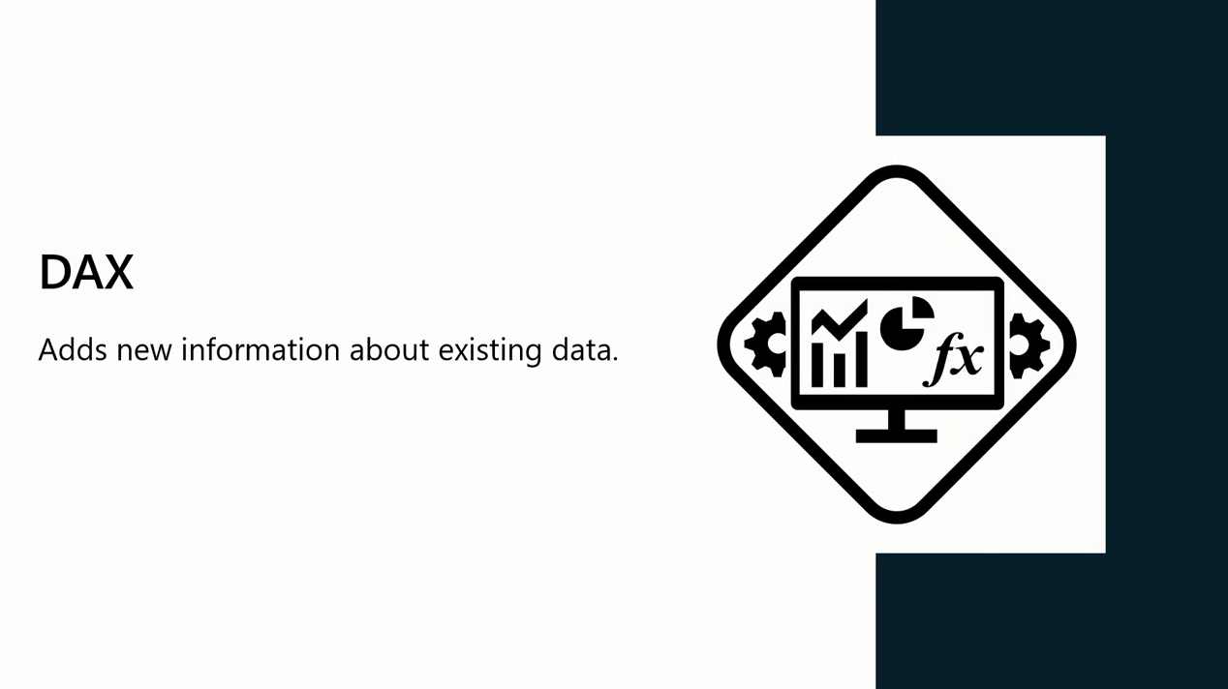
What is DAX ?
Data Analysis Expression

Slide 43
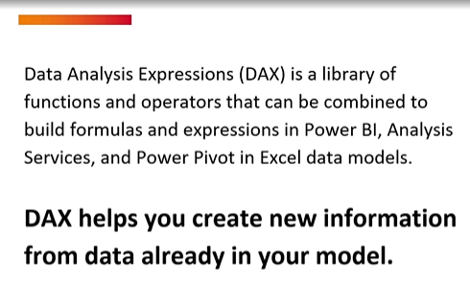
What is DAX ?

Slide 44



What is DAX ?
DAX is a programming language used in:
Microsoft SQL Server Analysis Services,
Power Pivot in Excel, and
Power BI.

Slide 45

What is DAX ?

Slide 46
What is DAX ?
It is a library of:
functions,
operators, and
constants
Used in formulas or expressions to create additional information about the data are not present in the original data model.
With DAX expressions, you can create custom calculations on data models to extract maximum information from your data to solve real-world problems.

Slide 47

How Dax Can Help You?

Slide 48

Syntax

Slide 49

Syntax

Slide 50

Syntax

Slide 51

Example
Company needs total Quantity Sold

Slide 52

New Calculated Colum
DAX
Aggregation Function
Table Name
Column Name

Slide 53

Example

Slide 54

Demo 2:
Creating Calculated Columns

Slide 55

What is Measures

Slide 56

What is Measures

Slide 57

What is Measures
Measures are used in Power BI to perform aggregations, calculations or evaluations on data that provide meaningful insights

Slide 58

What is Measures
Measures are typically used in data visualization elements

Slide 59

What is Measures

Slide 60

Measure Syntax
Measure Name
Example

Slide 61
Demo 3:
Creating Measures

Slide 62


